Slide 1
.NET ASPIRE, come gestire una applicazione distribuita
Andrea Tosato

Slide 2
Sponsor

Slide 3
Every App Needs
Observability
Resiliency
Scalability
Manageability

Slide 4
.NET 8 Includes
Observability
Resiliency
Scalability
Manageability
Built in metrics with dimensions
New Polly based resiliency packages
AOT (increased density)
Certificate auto-rotation support in Kestrel
DI integration for metrics
SignalR Stateful Reconnect
Performance
Better Logging support (faster, can object serialization)
Chiseled Ubuntu
Enrichment
Redaction
Testing fakes for Logging & Metrics
Notes:
Now inside of .NET you have the ability to not only build these applications but integrate into all of these different parts and in .NET eight the team added even more goodness across all of these different key areas for developers. This means at your fingertips you can easily integrate different NuGet packages and services from the frameworks into your applications to make them more observable resilient scalable and manageable in the long run.

Slide 5
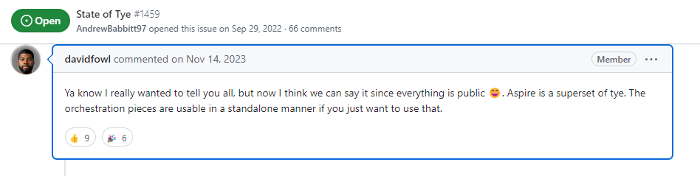
History of .NET ASPIRE
Project Tye
Tye is a developer tool that makes developing, testing, and deploying microservices and distributed applications easier. Project Tye includes a local orchestrator to make developing microservices easier and the ability to deploy microservices to Kubernetes with minimal configuration.
Tye can:
Simplify microservices development by making it easy to:
Run many services with one command
Use dependencies in containers
Discover addresses of other services using simple conventions
Deploy .NET applications to Kubernetes by:
Automatically containerizing .NET applications
Generating Kubernetes manifests with minimal knowledge or configuration
Using the same conventions as development to keep it consistent

Slide 6
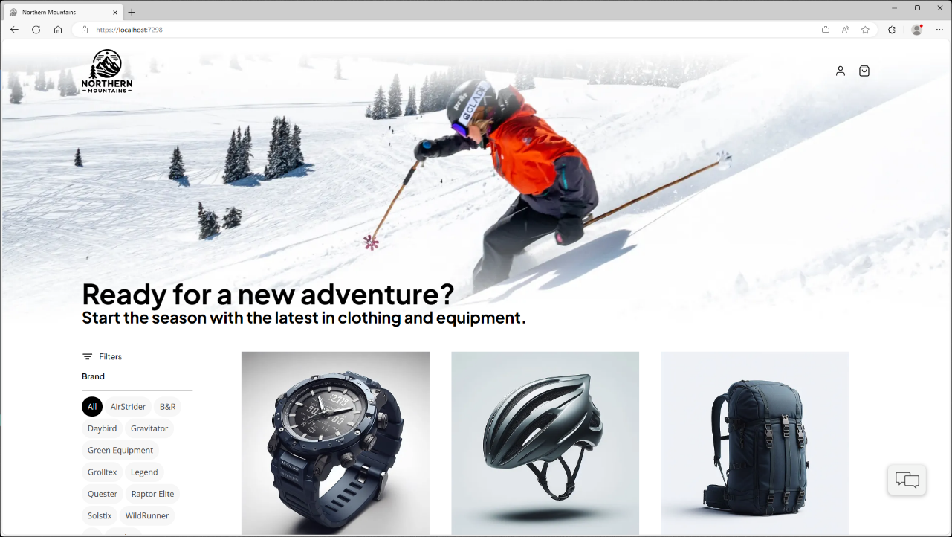
Example of realworld application
Notes:
Let's say you're building a website, here for example is a sports website that many of us maybe have built or at least browsed online now we think to ourselves what goes into building this application and you might have a small team or you might have a big team that's building this type of app.

Slide 7

How you may build a POC
Cloud Services
Web App
Blazor App
Data Source
Notes:
Let’s start at the very beginner of how I would build this app. I would spin up a Blazor web app with some data. Maybe it is hardcoded or in a json file, or even maybe a small SQLite database. With just a single web app there is plenty that .NET Aspire can help me with we will get into.

Slide 8

Add an API and database
Cloud Services
Web App
Blazor App
Backend API
PostgreSQL
Identity
Catalog
Order
Basket
Payment
Notes:
.NET Aspire starts to shine as your application grows. A common scenario for developers are building a backend for their frontend side by side. The backend usually talks to a database and has multiple APIs that the web app can talk to. There are several features of .NET Aspire that this type of application can take advantage of.

Slide 9





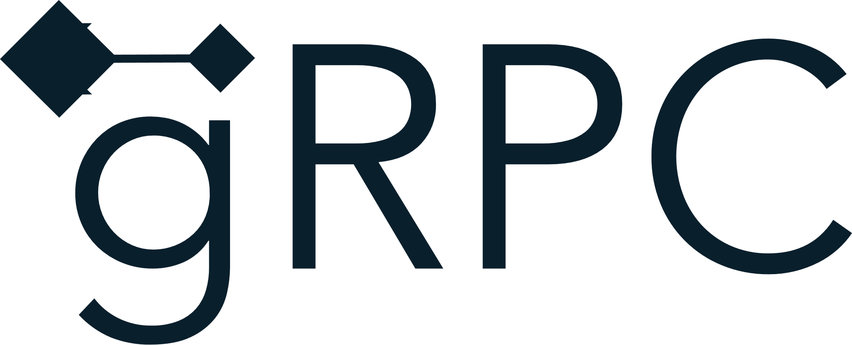
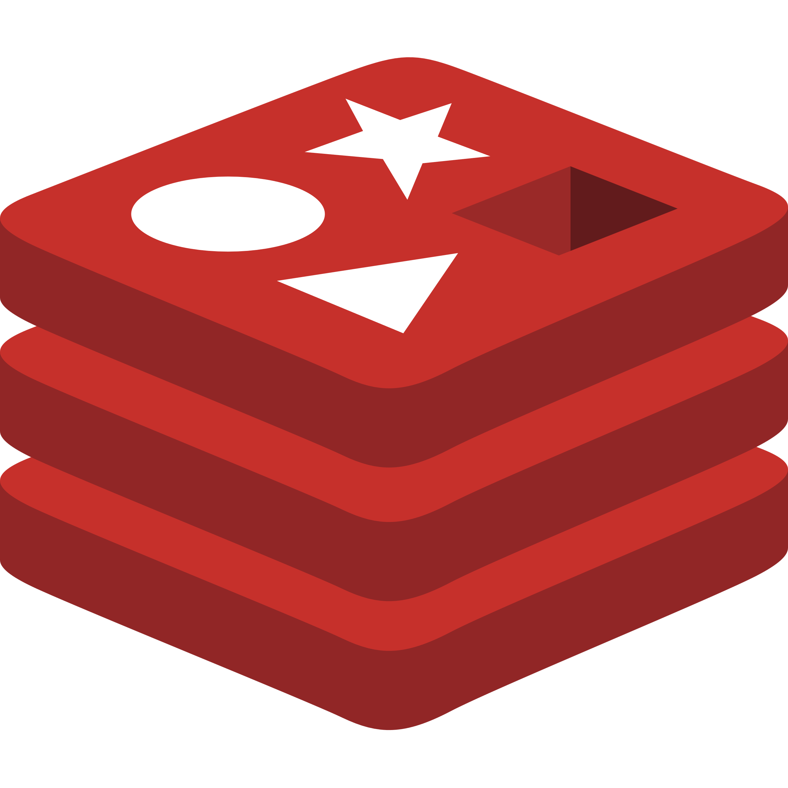
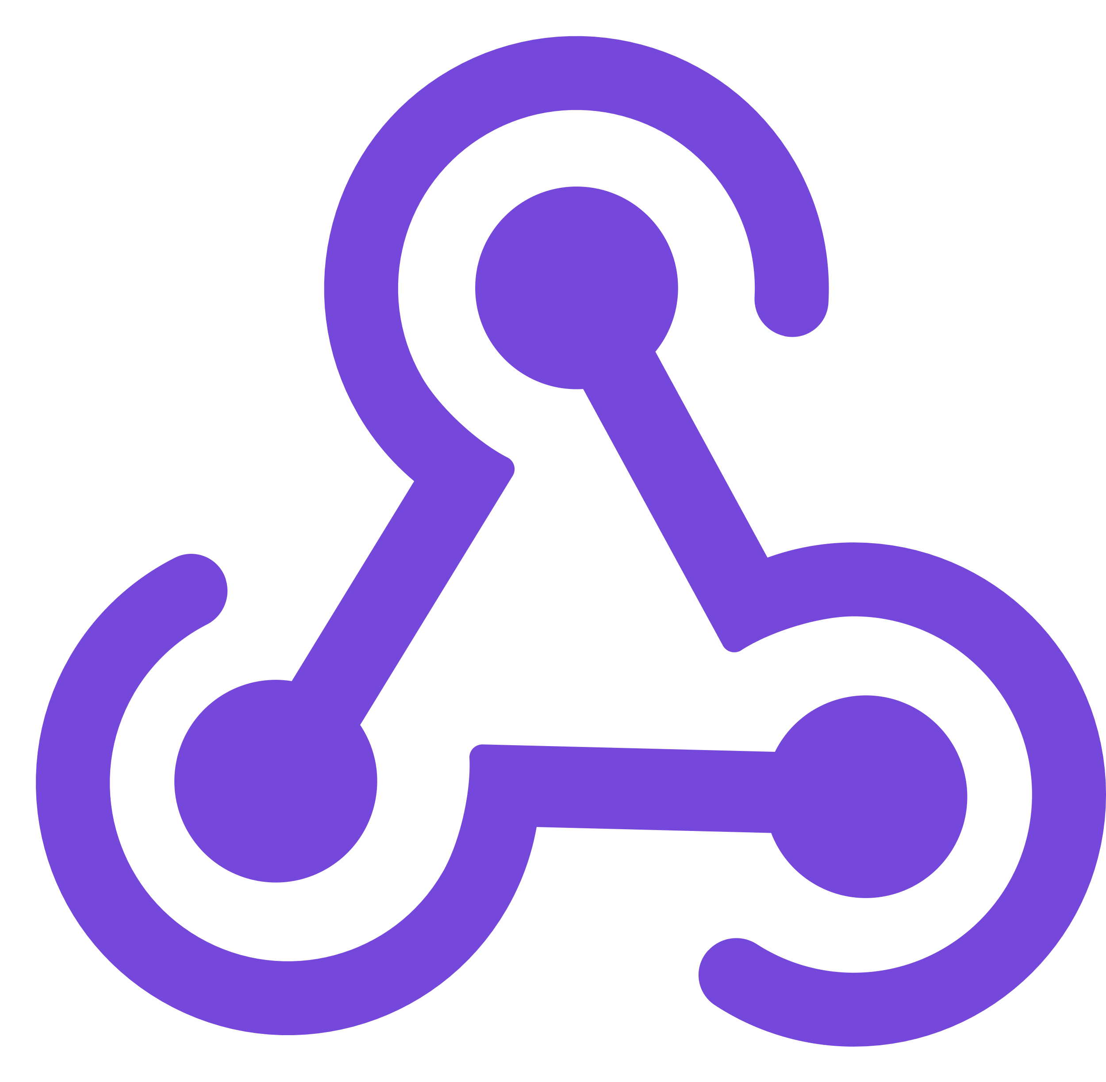

Full architecture reference
Cloud Services
Client Apps
Identity Service
Mobile BFF
Identity API
PostgreSQL
Mobile App
OpenAI
Mobile API
Catalog Service
Catalog API
PostgreSQL
Order Service
Ordering API
Web App
Ordering API
Order Processor
PostgreSQL
Event Bus
Browser
Blazor App
Basket Service
Basket API
Redis
Payment Service
Payment Processor
Admin Services
Webhook Client
Webhooks Service
Observability
Webhooks API
PostgreSQL
Notes:
At some point you may start to build out a fully distributed cloud-native architected project with lots of different dependences.
In each these scenarios whether your application is small as a single API with the front end and a back-end or a full cloud native distributed application .NET Aspire is a great use case for you.

Slide 10
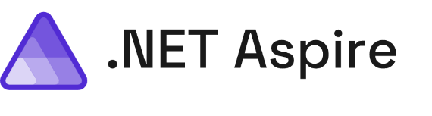
.NET Aspire Includes…
A cloud ready stack for building observable, production ready, distributed applications
Smart Defaults
Developer Dashboard
Orchestration
Service Discovery
Integrations
Deployment
Notes:
So what's in .NET Aspire? There's a series of different features that help developers be more productive, build better observable production ready distributed applications, and ease the deployment in many scenarios for us. We're going to take a look at every single one of these different features from start to finish and integrate them into our application. Now a lot of people start with the developer dashboard because it's the fancy shiny thing that ships directly with .NET Aspire but we're going to start in a different area first which I think is one of the areas and features that every single application should integrate into our application today

Slide 11
Service Defaults Overview
.NET Aspire Service Defaults
Observability
Resiliency
Health Checks
Notes:
Well, there are several things that every single type of application needs, and they're integrated directly into the .NET SDK or packages. If you want to go ahead and configure all of these yourselves you totally can and many applications today might add one or two of these different areas but with smart defaults with one single project added into your solution, you will be able to integrate in a set of defaults are recommended by the asp.NET core team into your applications let's see what that means.

Slide 12
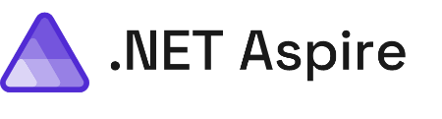
Developer Dashboard Overviw
Developer Dashboard
Structured Logs
Metrics
Distributed Traces
Dependencies
Notes:
And that is where the developer dashboard comes in the developer dashboard for .NET Aspire gives you a one stop shop for an entire overview of your application including see all of your projects and dependencies running and giving you deep visualization of all of that OpenTelemetry data all coming in via the gRPC exporter. The dashboard is amazing because it's built 100% open source with .NET, Blazor, and FluentUI.

Slide 13
Orchestration
A cloud ready stack for building observable, production ready, distributed applications
Smart Defaults
Developer Dashboard
Orchestration
Service Discovery
Integrations
Deployment
Notes:
As I mentioned, orchestration is one of the main feature of .NET Aspire. But what does that look like in practice?

Slide 14
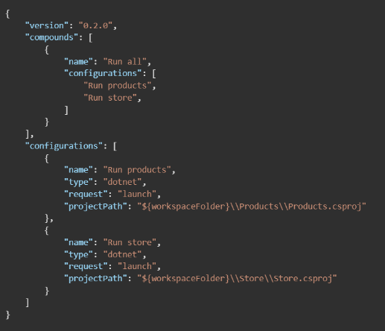
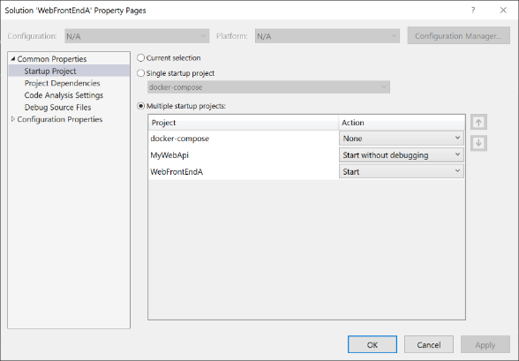
Orchestration Before
Notes:
So currently today and as you just saw if we wanted to run multiple services all at the same time and debug them we're going to have to run multiple commands or configure VS Code or Visual Studio to set up multiple startup projects. Additionally, if we have other dependencies such as this case maybe a database or another container, we're going to also have to spin them up automatically.

Slide 15
Service Discovery
A cloud ready stack for building observable, production ready, distributed applications
Smart Defaults
Developer Dashboard
Orchestration
Service Discovery
Integrations
Deployment
Notes:
With orchestration, the .NET Aspire app host knows what to start up but we can also configure it so it knows about project dependencies, and it can enable applications to automatically discover each other so we don't have to use hard coded strings.

Slide 16
Service Discovery Before
{
"Logging": {
"LogLevel": {
"Default": "Information",
"Microsoft.AspNetCore": "Warning"
}
},
"AllowedHosts": "*",
"ProductEndpoint": "http://localhost:5228",
"ProductEndpointHttps": "https://localhost:7130"
}
builder.Services.AddHttpClient<ProductService>(c =>
{
var url = builder.Configuration["ProductEndpoint"] ?? throw new
InvalidOperationException("ProductEndpoint is not set");
c.BaseAddress = new(url);
});
Notes:
And what I mean by that is that traditionally we would use connection strings this is a pretty standard practice inside of our development to define an endpoint in this case with a specific address. And then when we deploy our application we would update this endpoint in our back end wherever we're have it deployed with the actual production endpoint. And then in our application we would use our configuration to grab the specific endpoint out. As a developer though we have to configure our application with to configure our back end and of course we need to make sure that we are always adding and updating these connection strings as we develop. It sure would be nice if we could automatically have our applications discover each other if they depend on each other

Slide 17
Integrations
A cloud ready stack for building observable, production ready, distributed applications
Smart Defaults
Developer Dashboard
Orchestration
Service Discovery
Integrations
Deployment
Notes:
Now as we mentioned earlier our application is small today but it is using things such as a database but as our application grows we're going to start to integrate in more services and additional dependencies that we may want to use and that's where .NET Aspire integrations come in.

Slide 18
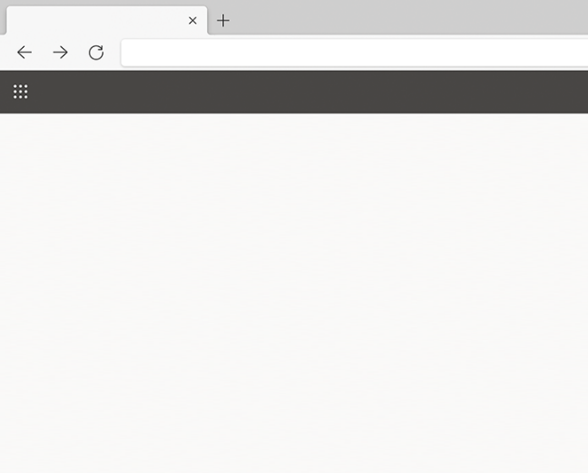

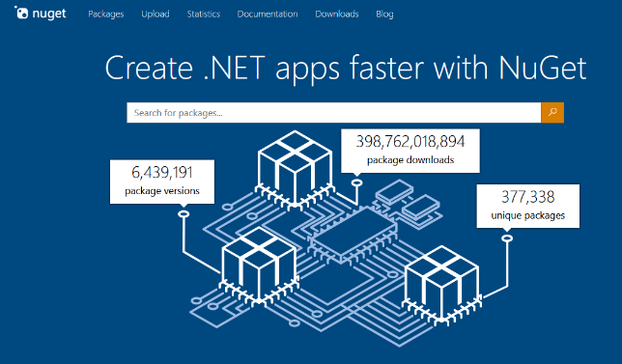
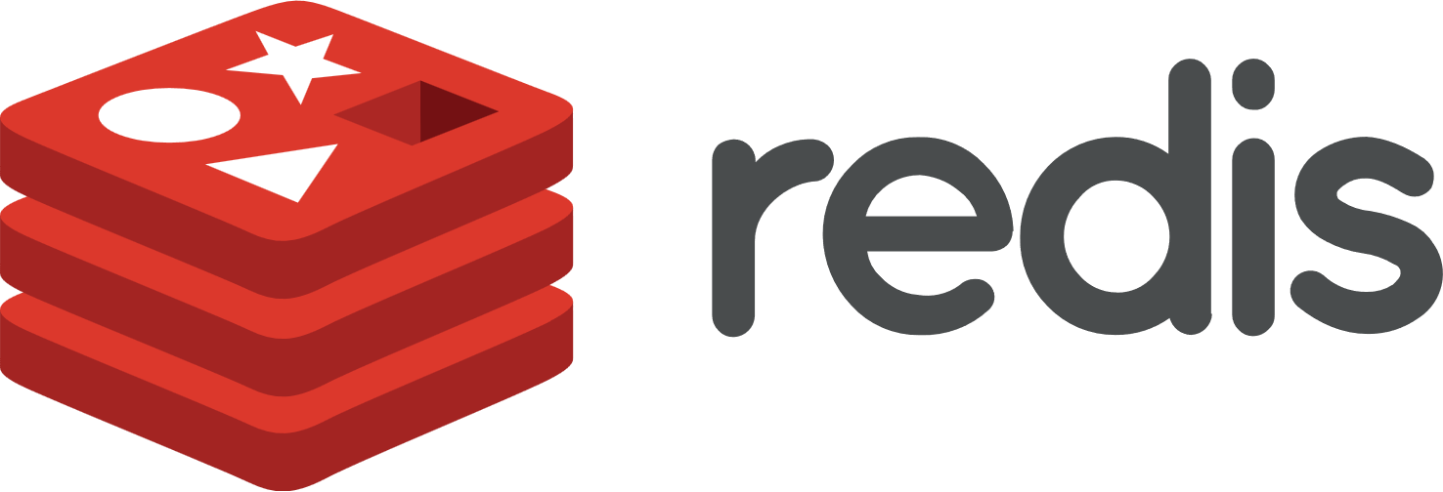









Integrations Overview
Nuget Gallery | Home
https://www.nuget.org
Integrations
.NET Aspire integrations overview - .NET Aspire | Microsoft Learn
Notes:
.NET Aspire integrations are a curated list of optimized libraries that are preconfigured to easily integrate into .NET Aspire app host projects and additionally into .NET projects directly that are being orchestrated with Aspire. So, this thing means things like SQL databases, Cosmos DB Azure integrations, Redis Cache, messaging, and a lot more and all of these are available open source and directly on NuGet. In addition to libraries from Microsoft and for Azure there's great integrations into other ecosystems as well such as AWS.

Slide 19
Deployment
A cloud ready stack for building observable, production ready, distributed applications
Smart Defaults
Developer Dashboard
Orchestration
Service Discovery
Integrations
Deployment
Notes:
All right finally is the deployment phase of the application because .NET Aspire as I've shown so far gives us a world class development experience and really helps us locally on our machine get deep insights into our application comma but at some time we need to be able to deploy it..

Slide 20







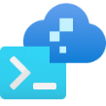





Flexibly Integrations and Deployment
Flexible Integrations & Deployment
How You Do It Today!
AWS CDK
Azure Dev CLI
Visual Studio
Notes:
So what are our options well the first thing is that you can continue to just deploy your application directly like you have been doing today. now it may mean that you need to add a few more connection strings or you may need to add in those dependencies into your deployment pipeline. But no matter where you're deploying your .NET applications today and whatever services you're using you can continue to deploy. In this case I may decide to integrate Azure Redis Cache and continue to deploy my application into App Service. Or I might decide that I want to take it further and I want to use things such as container apps to bundle up application article even further such as using Kubernetes services. But of course, you can deploy your application everywhere.
In addition to how you deploy today there's deep integrations for AWS and for Azure like we've seen with integrations but in additionally into the command line to help you get your services up and running. And of course it wouldn't be Visual Studio with a little right click publish. Visual Studio directly integrates into the Azure developer CLI to give you sort of an easy button to start to deploy your application. Visual Studio on Azure developer CLI can take your application and bundle it up automatically into containers and publish them to Azure Container Apps. Let's take a look and see what that looks like.

Slide 21
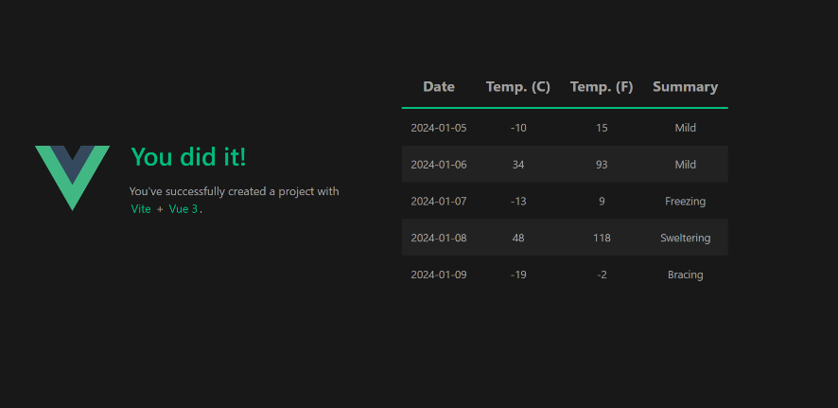
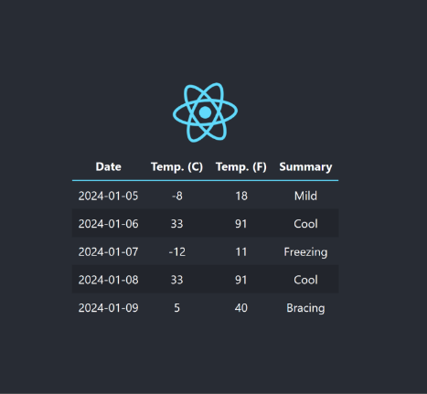
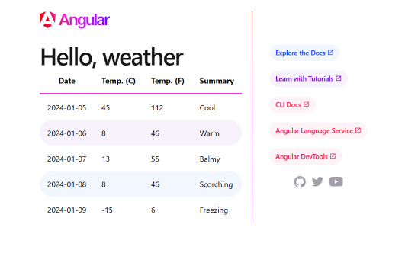
Add .NET Aspire to Any App
SPA frontend
Notes:
Now another thing I want to talk about really quick before we wrap this up is that I mentioned you can integrate other types of applications in to .NET Aspire systems. There's two specific ways of doing this one of just using open telemetry in your existing let's say JavaScript application and using the standalone Aspire dashboard. But additionally, you can integrate in node applications in to the app host to automatically run your node front end with your .NET backends.

Slide 22
DEMO

Slide 23



Grazie!
Your Photo
ATosato86
andreatosato
andreatosato
Andrea Tosato
andreatosato

